Slide 1

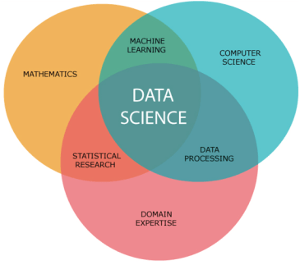
Is it possible to predict the Positive Rating of a store in Israel nowadays?
Lecturer: Dr. Jonathan Schler
Student Name:
Eyal Chachmishivly 209786094
Course details:
Introduction to Data science 67008-2

Slide 2

Introduction
Store Reviews in Israel this days
Analysis of store data for improvement and optimization for business owners
Understanding which parameters predict and help getting a better rating

Slide 3

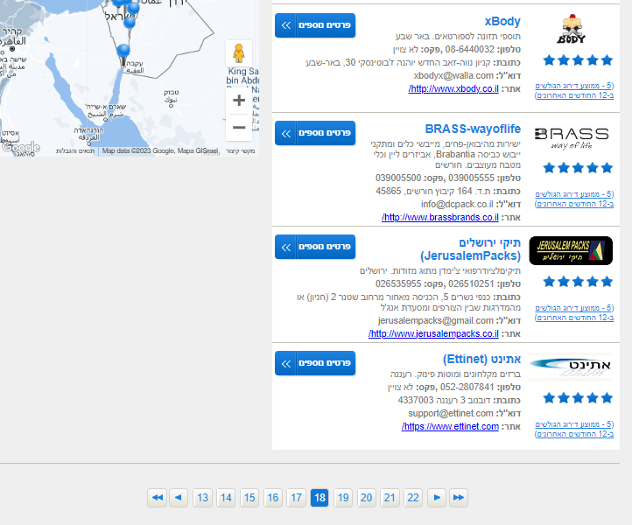
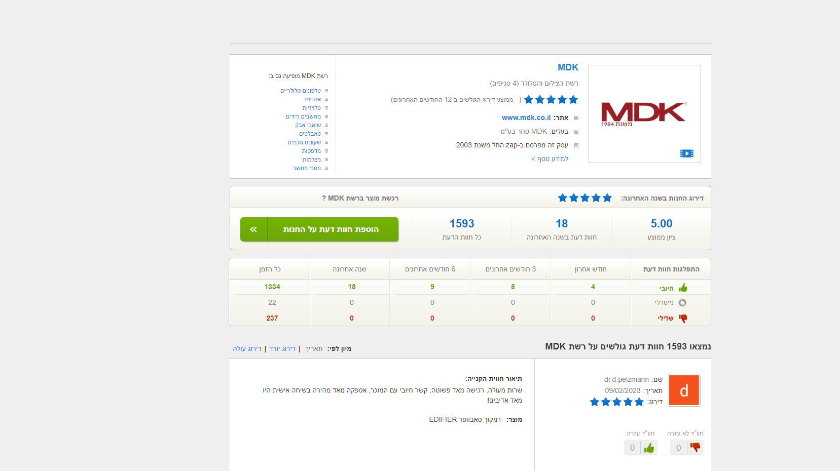
Data sources
Zap Stores:
Using Crawling from the website https://www.zap.co.il . This website provides a great
Amount of reviews for a huge amount of stores in Israel. The library I used for the crawling was BeautifulSoup

Slide 4
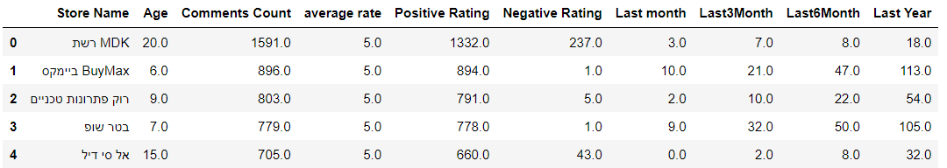
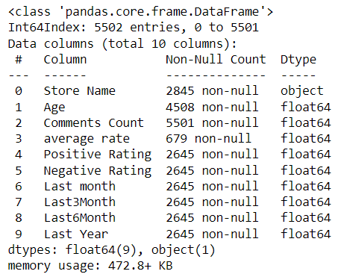
The Parameters and data before cleaning

Slide 5
DataFrame Cleanup
Dropping all the Rows that have missing Values(Contain NAN)
Dropping the average rate column that has more than 75% of missing values
Dropping the duplicated rows that contain the same store name
Using visualizations that show and detect outliers and later on show relations between the parameters

Slide 6
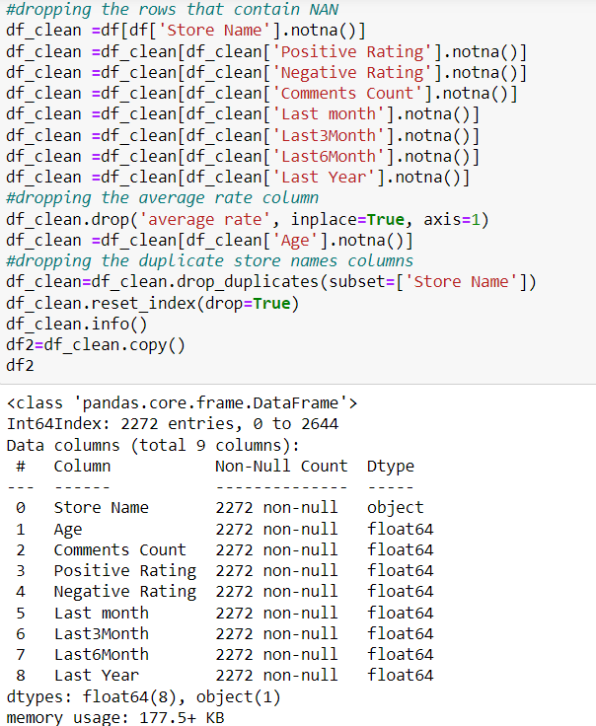
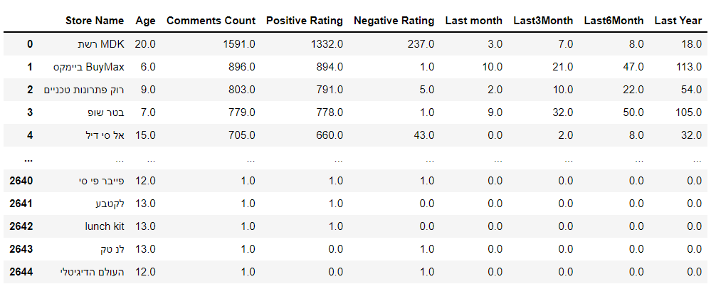
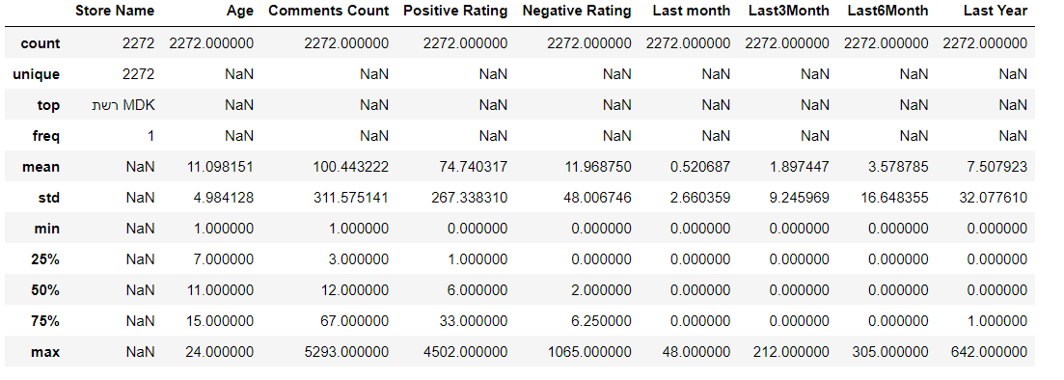
DataFrame and Cleanup

Slide 7
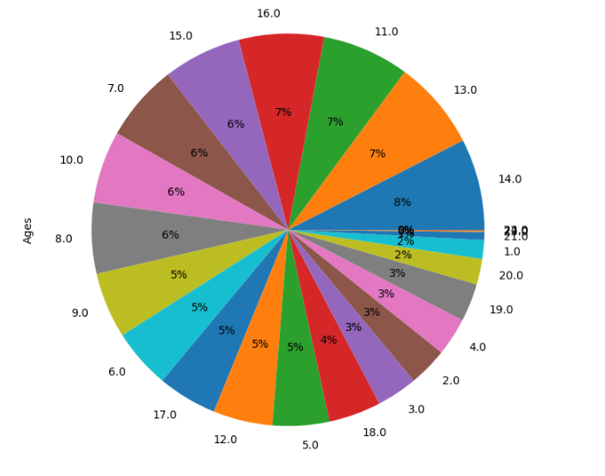
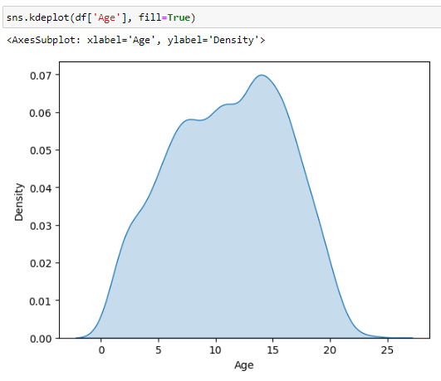

Visualiztions and EDA

Slide 8
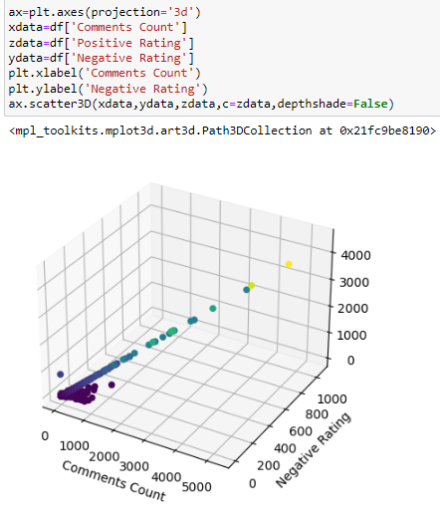
Visualiztions and EDA
Here we can see the use of the scatter3D. We can see the relation between parameters.

Slide 9
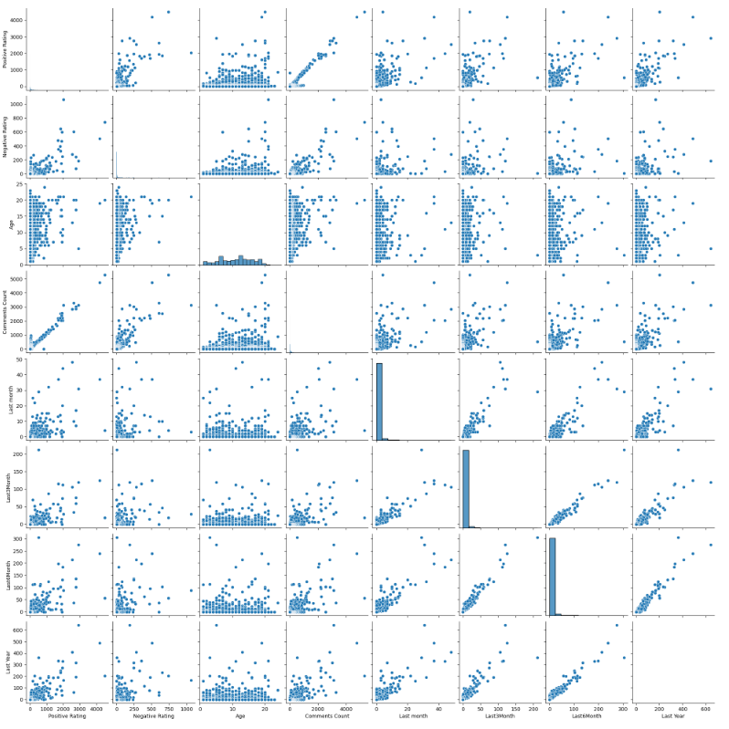
Visualiztions and EDA
Here we got a matrix of Scatter Plots according to the parameters that we just put in the function. This is a quick and an effective way to check a relation between this variables

Slide 10
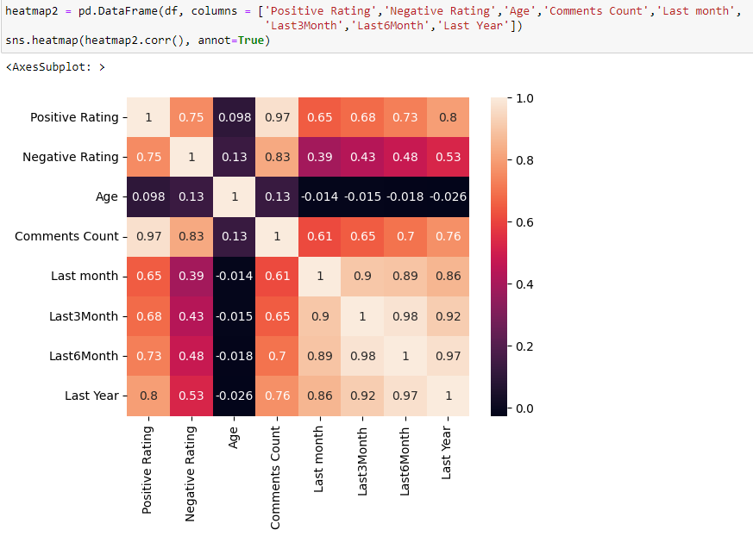
Visualiztions and EDA
We can see that some of the relations are linear. For example we can see it go for between the Positive Rating and The amount of comments.
To make stuff more easier, Let's visualize this correlations with the heatmap.
This visualization technique allows us to present third multiple dimensional data. Heatmaps show us values as a function of two dimensions.

Slide 11
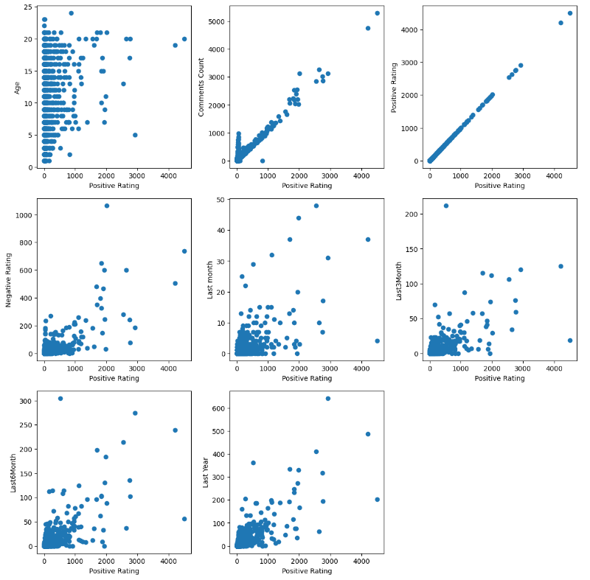
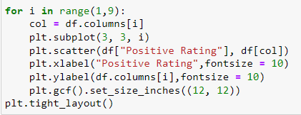
Visualiztions and EDA

Slide 12
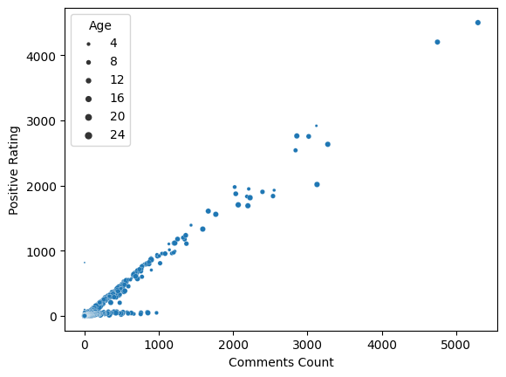
Visualiztions and EDA
for example, Again from here We can see from the second graph the more comments there are, The higher gets the positive rating. This EDAs will help us build a prediction model later on
Now lets take this specific graph and take a closer look at it by adding another element, age.

Slide 13
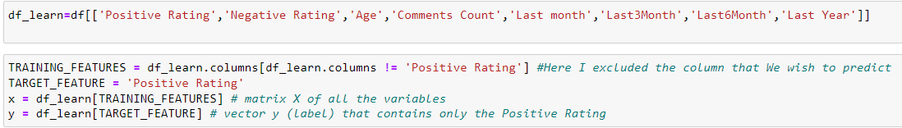
Machine Learning
The method I have chosen is Linear Regression since the problem I'm facing is a regression problem.
I wanted to predict the exact value and check how precisely I can predict it. The target column that I'll want to predict is the Positive Rating Column.

Slide 14
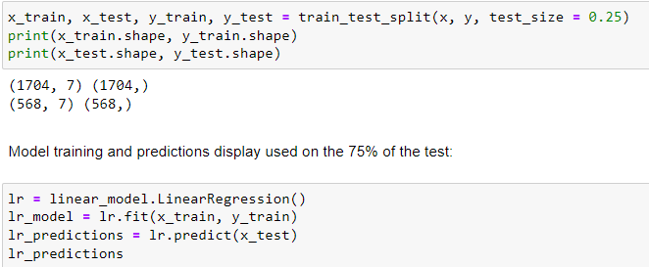
Linear Regression
First we'll use The train test method, which is used to split the data in a way that most values are used to train the model, and puts a small part of the data to test what the model learned.
test size will be 25% of the data. 75% of the data will be used to train the model.

Slide 15
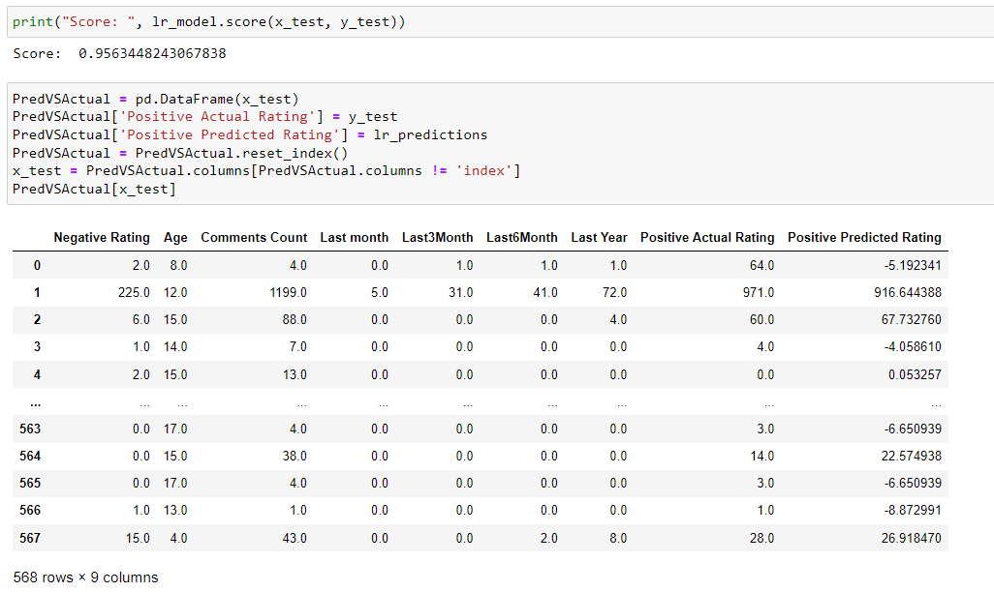
Precision of the predictions
Here we can see that the precision is adverbnearly 0.96 score which is excellent

Slide 16
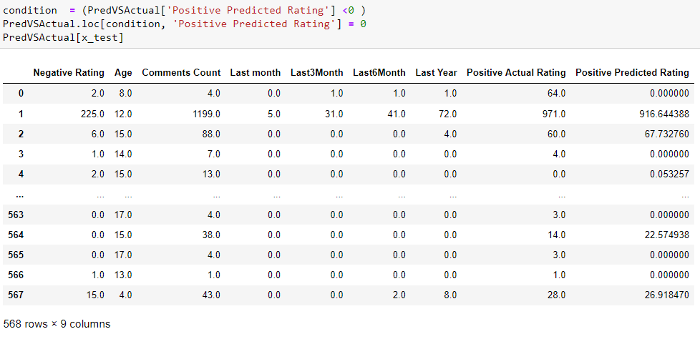
Precision of the predictions

